Slide 1

your digital future
Kathy Reid BA/BSc, MBA (Computing)
Independent Digital Technical Consultant
Director of Developer Relations, Mycroft.AI, President, Linux Australia
@KathyReid on Twitter, GitHub, LinkedIn etc.
Notes:
Thanks so much ANABEL
Hi everyone.
Firstly, I’d like to congratulate everyone tonight for choosing to be a part of the Girls Leading Advanced Manufacturing and Geelong Future Leaders in Industry programmes.
Digital technology, advanced manufacturing, the internet of things, 3D printing, robotics and automation will play a huge role in the future of our society, and you’ve already taken a huge step forward in gaining exposure to these areas.
(clapping)
When I asked Anabel what I should talk about tonight, she gave me some very simple instructions – or what appeared to be simple instructions.
My challenge was to:
INSPIRE YOU

Slide 2
20 billion connected devices, talking to each other on the Internet of Things
Ubiquitous connections – always on
The lines between technology and humanity are merging
A new era means new challenges
Notes:
So, inspiring you would be easy, right?
As I started to think about this, I thought about the digital future that’s beginning to emerge, and what you might find inspiring about it.
By the year 2020, there will be over 20 BILLION internet connected devices on the planet. That’s about 3 for every single person. Your fridge will be connected to the internet, your phones, light bulbs, goodness, we’re starting to see dog collars that are connected to the internet.
Devices will talk to each other and share information through connections that are ubiquitous – always on.
Technology will begin to blend with humanity. Machine learning and artificial intelligence are advancing every day, and we’re starting to see highly skilled professionals be assisted in their day to day tasks by artificial intelligences. Ais will help doctors detect cancer. Machine learning will help detect vulnerable people at risk, and who need additional support. New technology will be implantable, and embedded within our clothes, our jewellery, and within us.
And this new frontier will bring both new rewards and new challenges.
So, some of you might be inspired by the sheer scale of what our digital future looks like.

Slide 3
        Money
Notes:
But some of you, no doubt are more practically minded.
How many of you want to earn good money in your chosen career?
Great – engineering salaries are consistently some of the highest professional salaries, particularly if you combine engineering skills with leadership and project management skills.

Slide 4
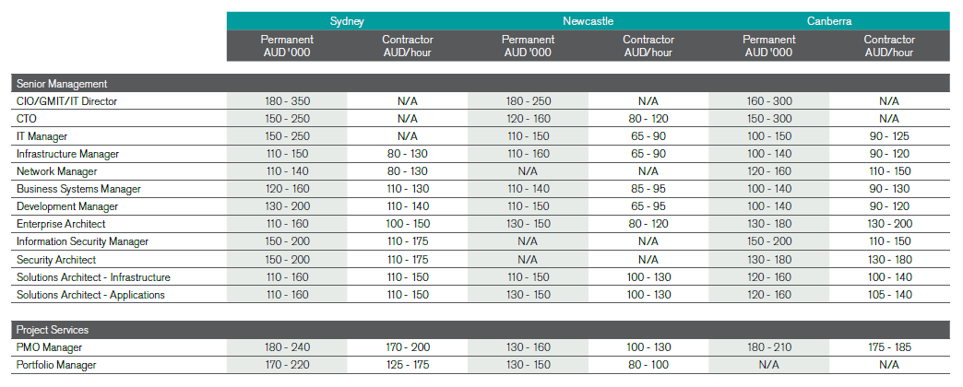
        Money
Notes:
And IT salaries are pretty good too – again, especially if you have leadership and management skills.

Slide 5
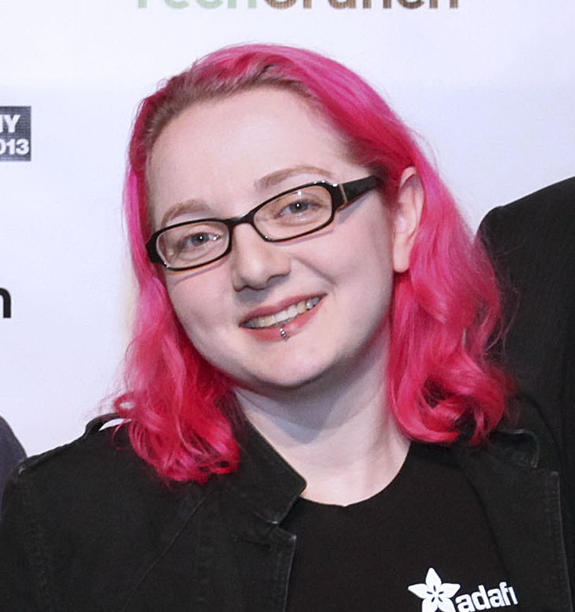

Igniting our desire to make, create and explore
As electronics and the Internet of Things becomes easier, companies are supporting our desire to ‘make’
Limor ‘LadyAda’ Fried
Electrical Engineer and Founder of AdaFruit Electronics
Background image: Limor Fried at TechCrunch Disrupt NY 2013 (cropped) Photo by Max Morse https://commons.wikimedia.org/wiki/File:Limor_Fried_TC2013.jpg
Notes:
But it’s not just about money.
Some of you no doubt enjoy tinkering with things, exploring how things are made – pulling things apart and putting them back together.
Anyone enjoy doing that?
(Hands raise)
What if you could turn something you love doing into your career?
The internet of things and the rise of hobbyist electronics is also spurring – the Maker Movement, makerspaces and hackerspaces - and we’re seeing the rise of services catering to this movement.
This is Lady Ada – Limor Fried – and in 2005 she founded AdaFruit, an electronics company, that this week bought out RadioShack, one of the largest electronics companies in America.
Oh, she has a Masters in Electrical Engineering, too ☺
She turned her hobby, her passion, into a lucrative career – and you might be inspired to do the same.

Slide 6
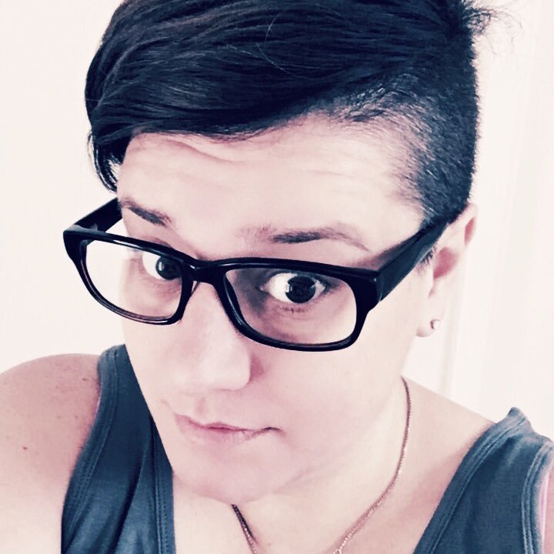
Helping people
As the average age of Australian first time Mums edges over 30, many couples need assistance in fertility and conception
Dr Hannah Brown, Postdoctoral Fellow, University of Adelaide
Reproductive science, IVF and fertility scientist
Notes:
Different people are inspired by different things.
Who among you here would like to use your career to help people?
(Hands raise)
I see, quite a few!
This is Dr Hannah Brown – she’s a reproductive scientist in Adelaide, and she works with technology – like invitro fertilisation - that helps couples to have babies.

Slide 7
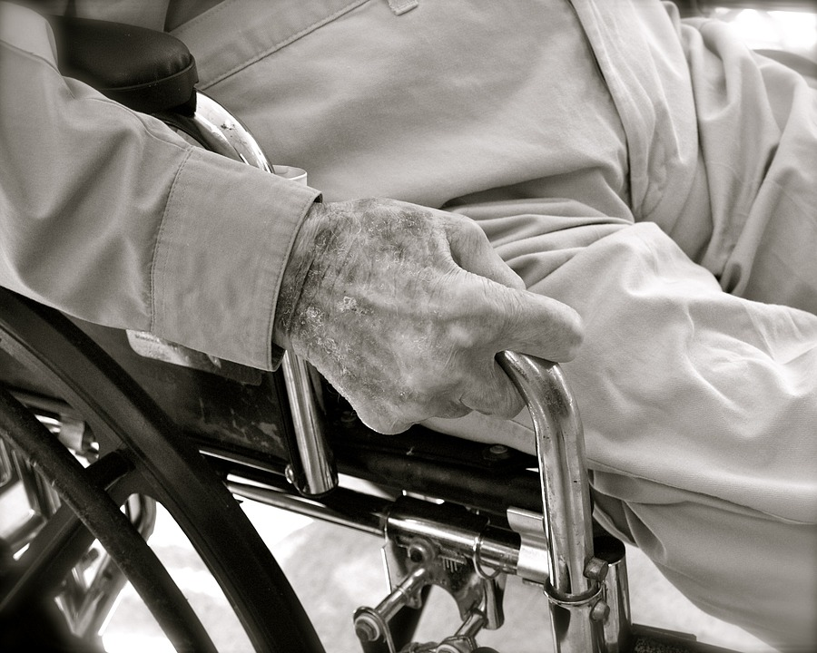
Helping people
Background image: Maxpixel http://maxpixel.freegreatpicture.com/static/photo/1x/Senior-Aging-Elderly-Aged-Mature-Person-2379003.jpg
Over the past two decades, the number of persons aged 85 years and over increased by 141.2%, compared with a total population growth of 32.4 over the same period
Source: Australian Bureau of Statistics
Notes:
How many of you have an elderly relative?
(Raise hands) I see – a few of you
We’re also seeing the rise of technologies like the internet of things to assist our growing elderly population, providing benefits like the ability to stay independent for longer, and to get assistance as soon as it’s required.
Over the next 20 to 30 years – the time span in which you’ll live your working lives – our elderly population is set to triple.
Manufacturing, engineering and technology advancements will help us provide better care to more Senior Australians.

Slide 8
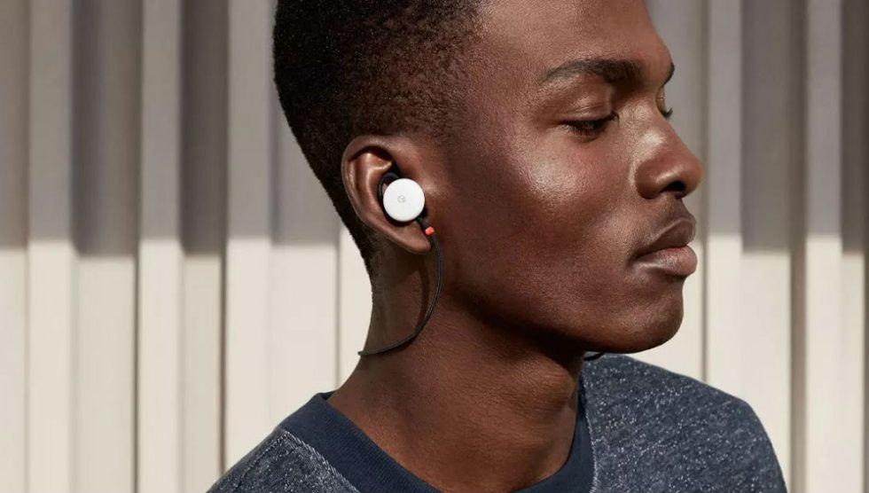
Connecting the world – breaking down barriers
Notes:
Technical advancements are also helping us connect with each other – not just across distances with technologies like video conferencing or FaceTime or Google Hangouts, but across language and cultural divides.
Several billion people on the planet don’t speak English.
Imagine if you could communicate with them. Imagine the possibilities that would open up, and the barriers that would come down.
This device is Google’s Pixel Ear buds, and they translate spoken language in real time. So you can be speaking Swahili, or Urdu, or Tieng Viet – to someone halfway across the planet.

Slide 9
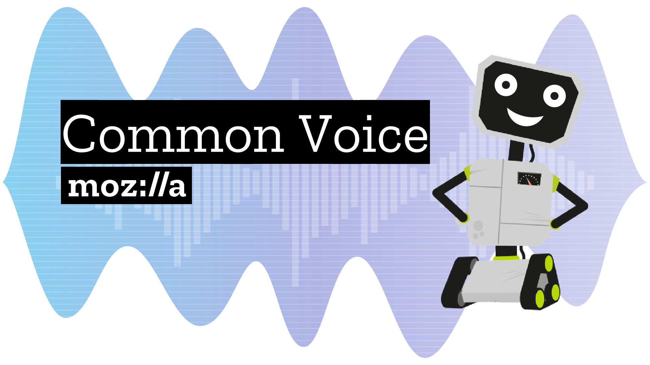
Notes:
On a similar note, this is Mozilla’s Common Voice project. They’re capturing voice samples from people all over the world – every language, every accent, every dialect – to make an open source collection. If anyone here has used an Amazon Alexa, or Siri, or Google Assistant, you’ll notice something about the voice – they all sound similar, very American. There are over 7 billion people in the world, and there are 7 billion voices.

Slide 10
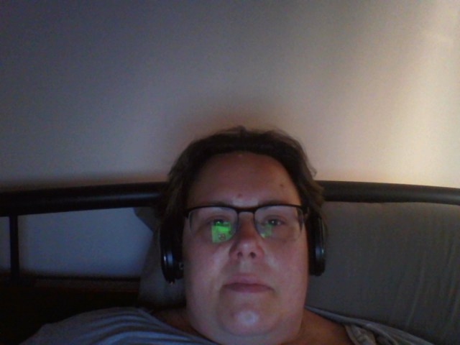
You can change the world.
Notes:
So yes, with a career in STEM – engineering, science, maths, technology – you have the ability
to earn a lot of money,
have great business opportunities,
the ability to help others,
break down barriers between cultures.
But there’s one other piece here, and it’s the most important.
You have the ability to change the world.
Don’t believe me?

Slide 11
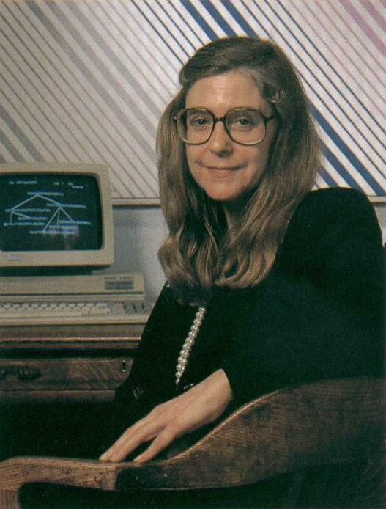
Margaret Hamilton
Computer scientist, NASA.
Wrote the code that put humans on the moon.
Notes:
This is Margaret Hamilton. She wrote the code for the Apollo space missions.
No biggie ☺

Slide 12
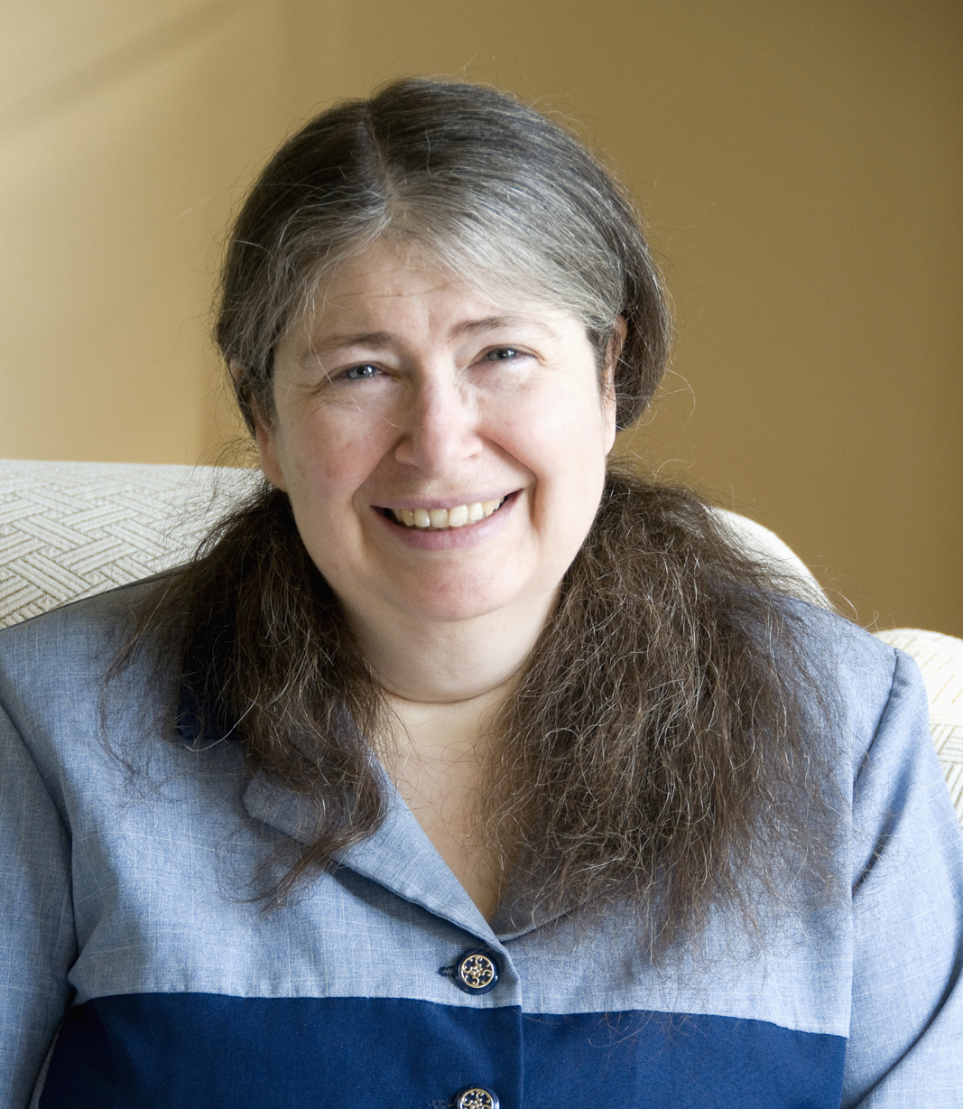
Radia Perlman
Computer scientist, Dell. “The mother of the internet”
Wrote something called Spanning Tree Protocol. It sounds mundane. It’s not.
Notes:
This is Radia Perlman. She’s a computer scientist. She wrote something called Spanning Tree Protocol. Every time you use the internet. Every time you log in to Facebook, send a Snap, your data follows paths determined by Spanning Tree Protocol. Without it, you wouldn’t have the internet.

Slide 13
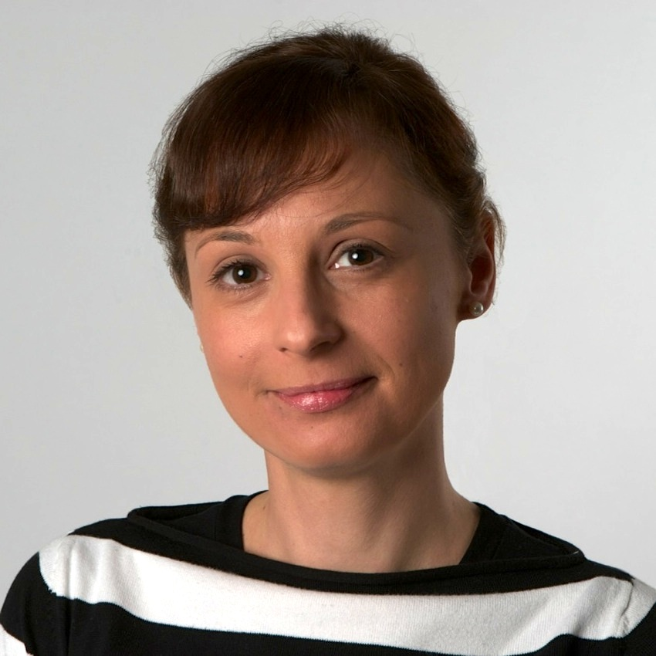
Catarina Mota
Founder of the Open Building Institute and OpenMaterials.org
Open source architecture – buildings for everyone
Notes:
This is Catarina Mota. She’s a materials engineer and is a specialist in smart materials.
Materials that react to things like body temperature, or movement.
She’s building the houses of the future, that have not only automation built in, but are built in such a way that they’re modular, easily expanded and can be built using sustainable, available materials in hostile environments. Like Mars.

Slide 14
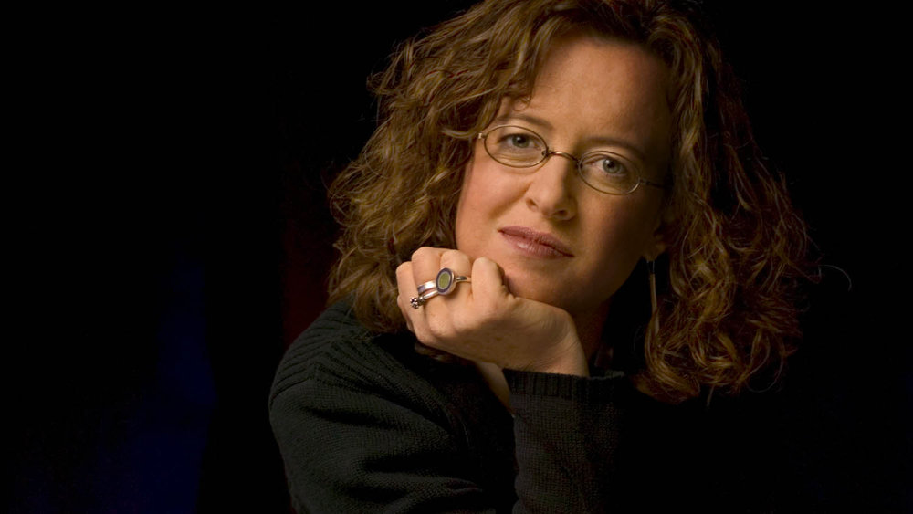
Professor Genevieve Bell
Director, 3A Institute (Autonomy, Agency, Assurance)
Artificial intelligence, machine ethics and anthropology
Australian National University
Notes:
This is Genevieve Bell. She doesn’t study machines, she studies people, and HOW they interact with machines.
She works on problems like how the technology we build should be more inclusive, and how technology is shaping our societies – and what changes we need to make to ensure that our societies are fair, and we think critically about the implications of the technologies we build.

Slide 15
Yes, really.
Notes:
All of these women are changing the world with their STEM skills – changing the world, and humanity, for the better.
And it was at this point that I realised I was asking the wrong question all the way throughout this presentation.
The question I was asking was
“How will I inspire you”
When really the question I should have been asking was
“How will you inspire me?”
“How will you change the world?”

Slide 16
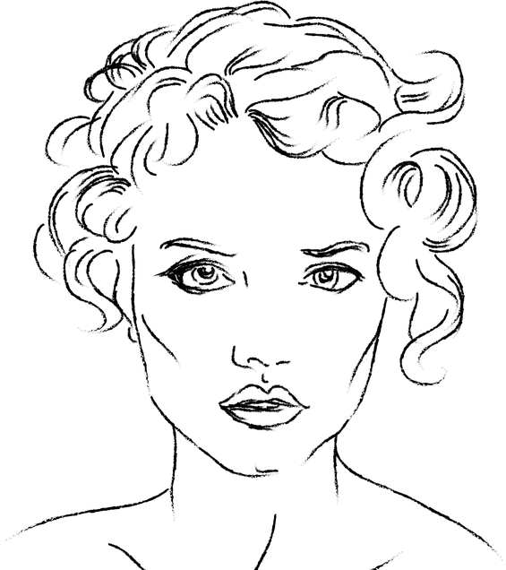
You
Nanotechnologist.
Quantum mechanist.
Machine ethicist.
Artificial intelligence engineer.
Astrophysicist.
Computational biologist.
Bioinformatician.
Advanced materials engineer.
Notes:
Best wishes on your STEM journey. Thank you.

